Slide 1
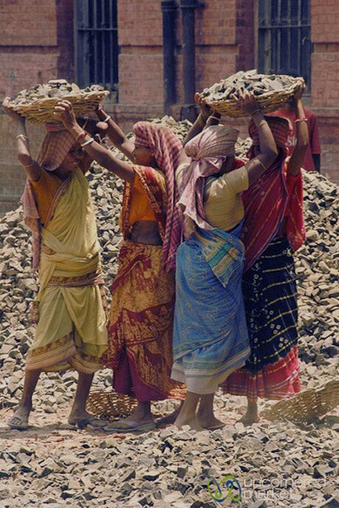
NREGA ANALYSIS
National Rural Employment Guarantee Act
Presented by :
Aleena Ejaz

Slide 2

CONTENT
01
Overview
02
Problem Statement
03
Dataset Information:
04
Analysis
05
Summary
06
Contact

Slide 3
OVERVIEW
he Mahatma Gandhi National Rural Employment Guarantee Act (MGNREGA), previously known as the National Rural Employment Guarantee Act (NREGA), represents a cornerstone of India's social welfare framework. This act ensures that rural households are entitled to a minimum of 100 days of wage-earning employment annually, provided that adult members are willing to engage in unskilled manual labor. The primary objectives of MGNREGA are to reduce rural poverty, empower women, and foster social inclusion.
01
Data Analysis and Strategic Insights
Our project uses SQL to deeply analyze MGNREGA data, uncovering key trends and patterns in its implementation and impact across different states. This analysis highlights areas of success and identifies opportunities for improvement.
02
Visualization with Power BI
Using Power BI, we create visualizations that clearly show employment distribution, financial expenditures, and gender participation across states. These interactive reports provide stakeholders with actionable insights and detailed data exploration to improve decision-making.
03
Recommendations and Limitations
Our analysis leads to specific recommendations for improving MGNREGA's efficiency and effectiveness. We suggest optimizing fund allocation, boosting employment opportunities, and empowering women. We also recognize limitations in data quality and scope and outline future steps to address these issues.

Slide 4
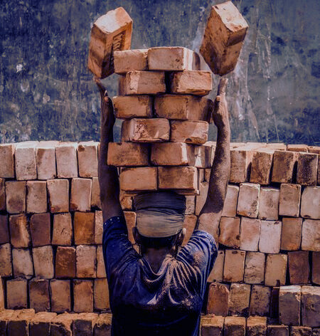
PROBLEM STATEMENT
NREGA is a vital initiative to alleviate rural unemployment and poverty. This project seeks to address several key questions and challenges associated with NREGA:
How effective is NREGA in providing employment opportunities to rural households?
Are there regional disparities in the implementation and outcomes of the scheme?
What is the utilization of the allocated budget, and how does it correlate with employment generation?
What are the key factors contributing to the completion of NREGA works, and are there any roadblocks to its success?
Can data-driven insights guide policymakers and administrators in optimizing the scheme's impact?

Slide 5
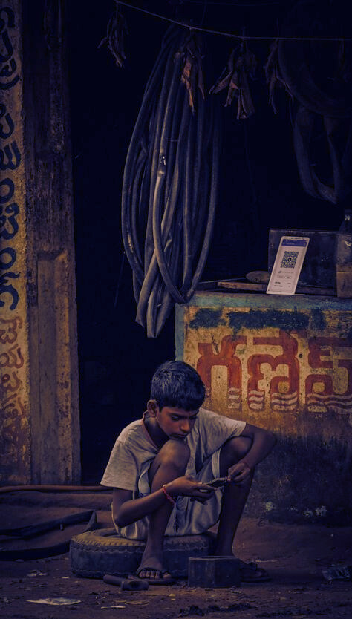
DATA SOURCE
The dataset used for this analysis is sourced from official government records and contains information related to NREGA implementation across various states and districts in India.
It contains 28 columns and 741 rows of data encompassing information on job cards, worker details, budget allocation, work completion statistics, expenditure, and more. This dataset offers a comprehensive view of the progress and challenges faced by the NREGA program.

Slide 6
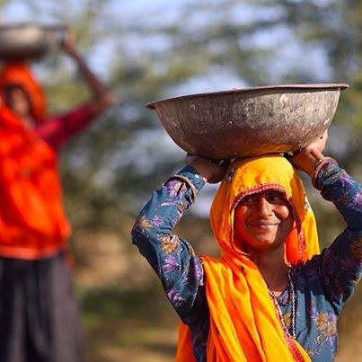
ANALYSIS

Slide 7
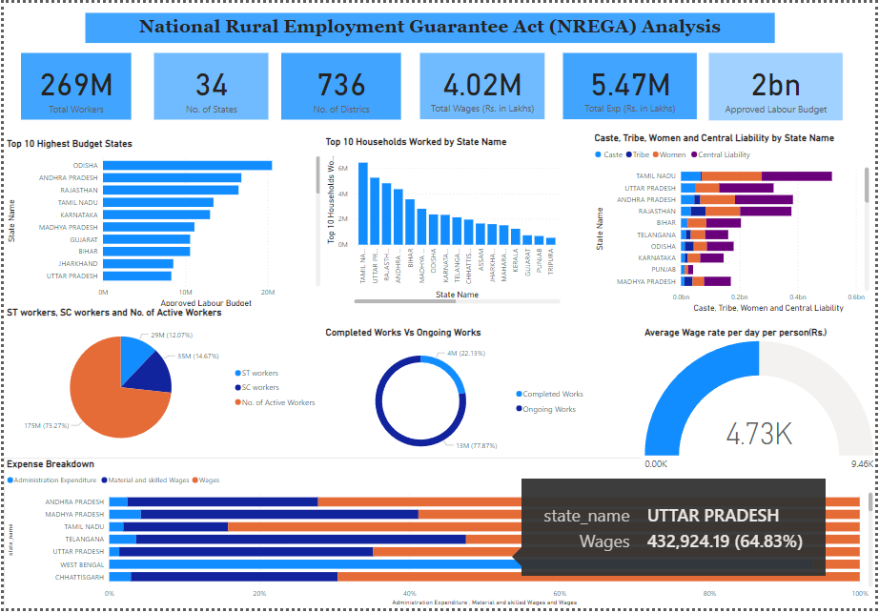
PROBLEM STATEMENT’S SOLUTION USING DASHBOARDS

Slide 8
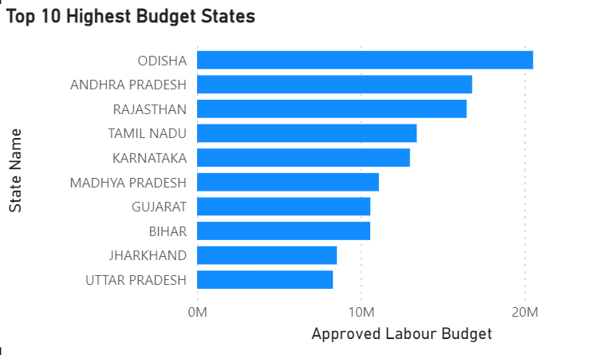
TOP 10 HIGHEST BUDGET STATES
Odisha receives the highest labor budget at 20,526,071, indicating a significant investment in rural employment and infrastructure development in the state.
Andhra Pradesh and Rajasthan follow with allocations of ₹16,800,000 and ₹16,461,577 respectively.
Tamil Nadu, Karnataka, and Madhya Pradesh have budgets between ₹11,104,617 and ₹13,417,861.
Gujarat, Bihar, Jharkhand, and Uttar Pradesh have labor budgets ranging from ₹8,292,811 to ₹10,581,146

Slide 9
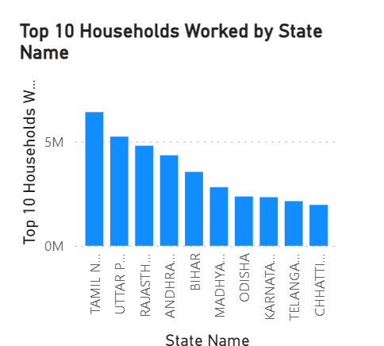
TOP 10 HOUSEHOLDS WORKED
Tamil Nadu tops the list with 6,410,901 households engaged. This substantial figure highlights the state’s significant reliance on MGNREGA for providing employment and supporting rural livelihoods.
Uttar Pradesh follows with 5,235,807 households and Rajasthan with 4,799,497 households.
Andhra Pradesh and Bihar show significant household participation, with 4,340,988 and 3,546,734 households respectively.
Telangana and Chhattisgarh engage 2,143,539 and 1,962,847 households respectively.

Slide 10
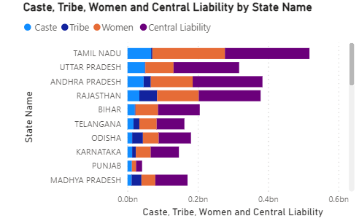
HIGHEST AND LOWEST POPULATION OF
SC, ST, WOMEN, CENTRAL LIABILITY
Caste Population:
Tamil Nadu has the highest caste population at 67,125,407.
Madhya Pradesh has the lowest caste population at 11,626,738.
Tribe Population:
Rajasthan has the highest tribe population at 50,534,895.
Punjab has the lowest tribe population at 5,618.
Women Population:
Andhra Pradesh has the highest women population at 119,060,226.
Punjab has the lowest women population at 11,816,501.
Central Liability:
Tamil Nadu has the highest central liability at 24,045,337.
Telangana has the lowest central liability at 7,878,571.

Slide 11
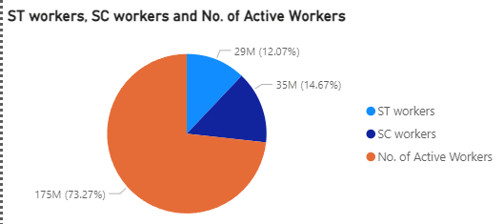
RATIO OF TOTAL ACTIVE WORKERS,
SC AND ST
Total Active Workers:
Comprise 175 million workers, which is 73.27% of the total.
SC Workers:
Make up 35 million workers, accounting for 14.67% of the total.
ST Workers:
Comprise 29 million workers, representing 12.07% of the total.

Slide 12
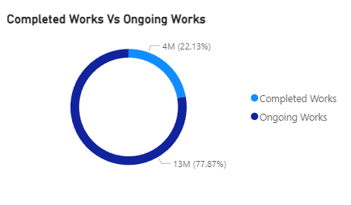
COMPLETED WORKS VS ONGOING WORKS
Completed Works:
Comprise 13 million work Completed, which is 77.87% of the total.
Ongoing Works:
4 million work ongoing, accounting for 22.13% of the total.

Slide 13
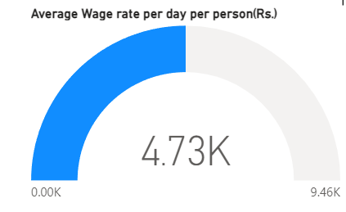
AVERAGE WAGE RATE PER DAY/PERSON
Lowest Wage Rate :
0.00K
Average Wage Rate :
4.73K
Highest Wage Rate :
9.46K

Slide 14
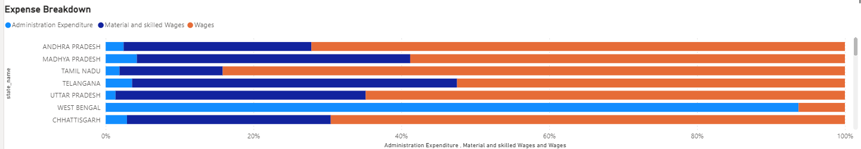
AVERAGE WAGE RATE PER DAY/PERSON
Andhra Pradesh has the highest Administration Expenditure (16,530.16) and Material and Skilled Wages (172,944.55). It also has a significantly high Wages expenditure (491,338.98).
Tamil Nadu has the highest Wages expenditure (612,138.44).
West Bengal has a moderate Administration Expenditure (6,273.89), zero Material and Skilled Wages, and very low Wages (419.85).

Slide 15
KEY INSIGHTS FROM THE MGNREGA DASHBOARD
Broad Participation:
Budget Allocation and Utilization:
Total Workforce: The scheme has engaged 269 million workers across India, reflecting its vast outreach.
State Coverage: MGNREGA is implemented in all 34 states, demonstrating its nationwide coverage and importance.
Approved Budget: The approved labor budget is ₹2 billion, indicating significant financial commitment to rural employment.
Top Budget States: Odisha, Andhra Pradesh, and Rajasthan are among the top states with the highest labor budgets, suggesting higher demand and resource allocation in these areas.
Wage Distribution:
Expense Breakdown:
Expenditure Categories: A significant portion of funds is allocated to wages, followed by material and skilled wages, and administrative expenses. Andhra Pradesh, Tamil Nadu, and Telangana show notable expenditures in wages and materials.
Administrative Costs: Lower administrative expenditures in comparison to other costs reflect an emphasis on direct labor benefits.
Total Wages: Workers have earned a cumulative total of ₹4.02 million in wages, highlighting the scheme's role in providing direct financial support.
Average Wage Rate: The average wage rate per person is ₹4.73k per day, crucial for assessing the economic impact on households.

Slide 16

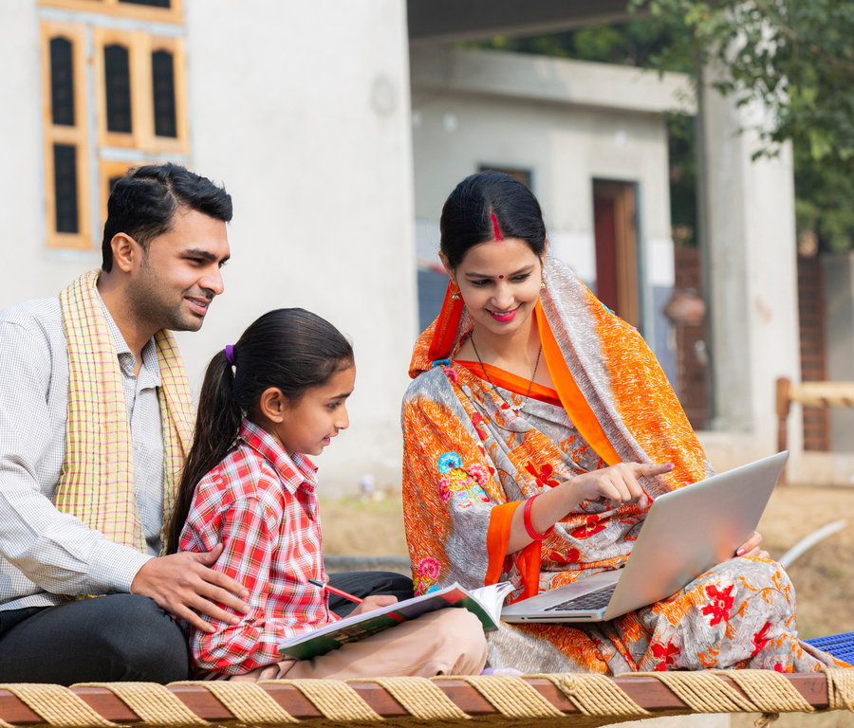
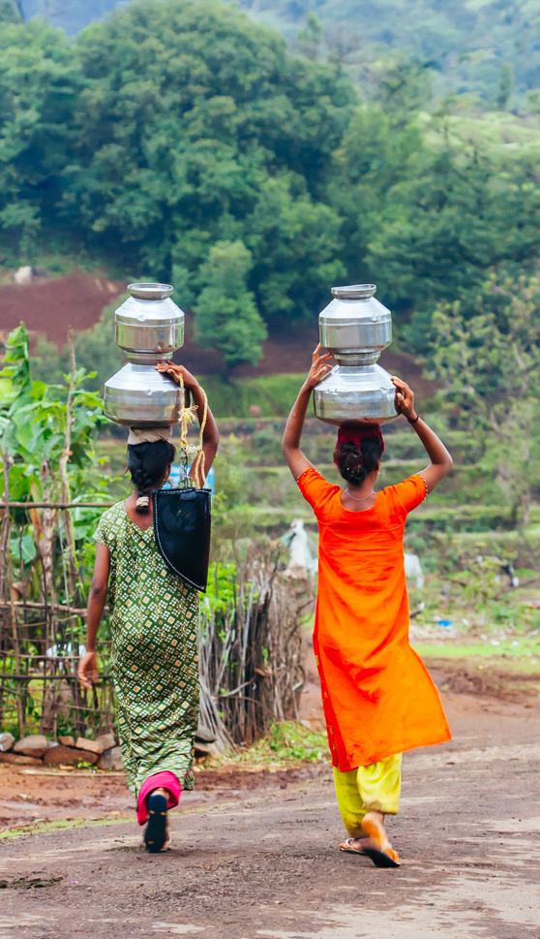

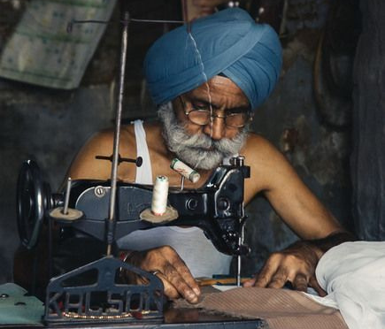
SUMMARY
The dashboard highlights the extensive reach and financial impact of MGNREGA, with strong participation from diverse groups and significant budget allocations. States like Tamil Nadu, Uttar Pradesh, and Andhra Pradesh lead in various performance metrics, demonstrating effective utilization of the scheme. However, there is room for improvement in project completion rates and optimizing administrative expenses. These insights can guide further enhancements to maximize MGNREGA's effectiveness and outreach.

Slide 17
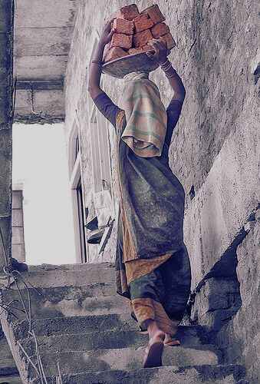


THANK YOU
FOR YOUR ATTENTION
aleenaejaz101@gmail.com
www.linkedin.com/in/aleena-ejaz

